Slide 1
ConstraintLayout

Slide 2
Contents
Introduction to ConstraintLayout in Android
Constrainst attributes & How to create constraint
Using chains for complex layouts
Using bias for flexible UI design
Using guideline, Flow, Barrier, Chain, etc.

Slide 3
Introdution – Advantages of ConstraintLayout
ConstrainLayout provides a flexible and powerful way to create complex layouts in Android, allowing for better control over UI elements positioning and sizing.
Responsive design: easier to create responsive designs that adapt to different screen sizes and orientations enhancing the user experience across various devices.
Using ConstraintLayout helps in maintaining a flat view hierarchy, which can lead to improved performance and efficiency in android app development.

Slide 4
Features of ConstraintLayout
1. Guidelines for Constraints: Following proper guidelines for setting constraints ensures consistent and predictable behavior of UI elements within the layout, resulting in a polished user interface.
2. Avoiding Nested Layouts: ConstraintLayout allows for the reduction of nested layouts, which can lead to more efficient Ul rendering and improved app performance.
3. Utilizing Chains for Alignment: Chains in ConstraintLayout provide a powerful way to align and distribute UI elements, contributing to a visually appealing and organized layout design.
4. Barrier and Group Usage: Incorporating barriers and groups in ConstraintLayout facilitates the creation of complex and responsive layouts, allowing for efficient management of UI components.

Slide 5
Constraint attributes and creating constraints
In Android development, a Constraint in ConstraintLayout is a rule or connection that defines how a view should be positioned and sized relative to other views or the parent layout. These constraints allow for flexible and complex UI designs without nested view hierarchies.
Anchors: Each view has anchors on its sides (left, right, top, bottom) and also baseline, center, and more. Constraints are created by connecting these anchors to each other or to the parent container.

Slide 6
Constraint attributes and creating constraints
Types of relative Constraints:
Parent Constraint: Connects the view to the edge of the parent layout.
Sibling Constraint: Connects the view to another view within the same ConstraintLayout.
Type of direction constraint:
Horizontal Constraints: Define the horizontal position of a view.
Vertical Constraints: Define the vertical position of a view.
One view have to have at least one horizontal constraint and one vertical constraint.

Slide 7
Constraint attributes and creating constraints
Utilities
Bias: Defines the bias for a view along an axis, which determines how much space is taken up by each side of the constraint. For example, a horizontal bias of 0.5 positions the view in the center horizontally.
Chains: Allows you to create a chain of views that share a common axis, allowing for complex alignment and distribution.
Guidelines: Invisible lines that views can be constrained to, allowing for easier and more flexible design layouts.
Flow
Barrier

Slide 8
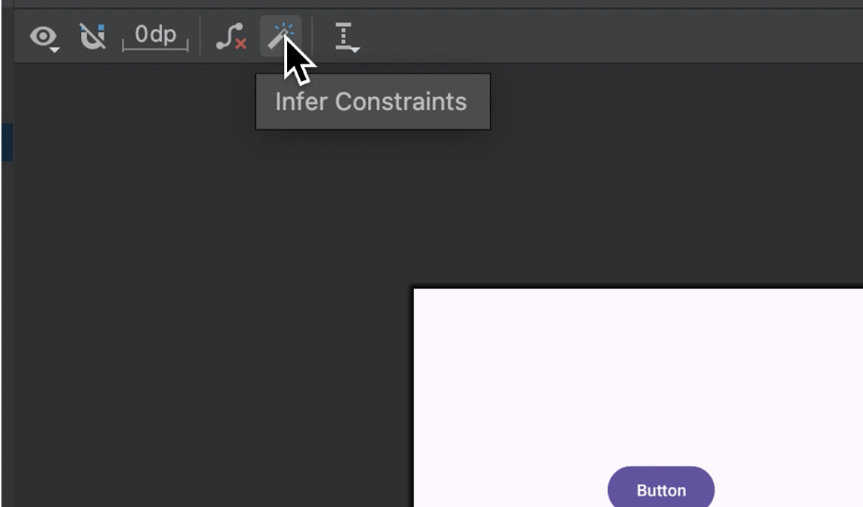
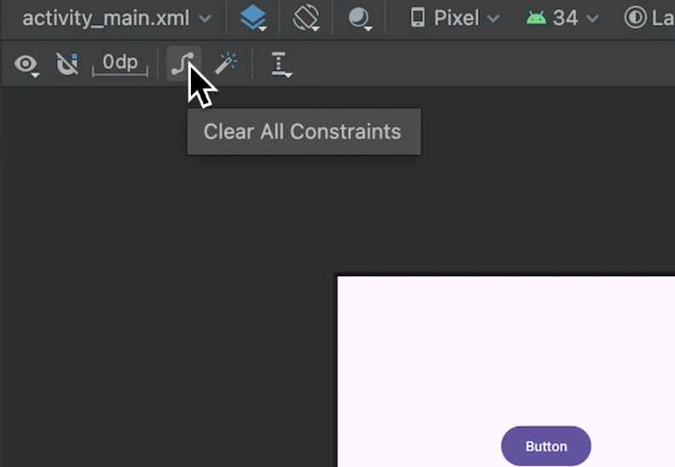
Constraint attributes and creating constraints
Create constraints
Method 1: Using Infer constraints: auto-create all constraints
Note: Don’t overuse this method. It doesn’t respondsive

Slide 9
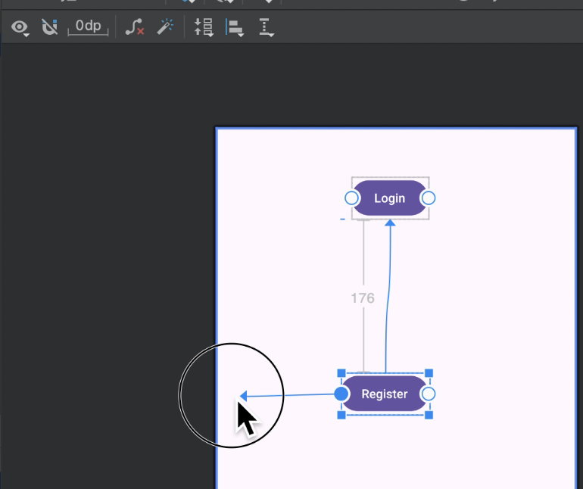
Constraint attributes and creating constraints
Create constraints
Method 2: Using drag and drop 4 anchors

Slide 10
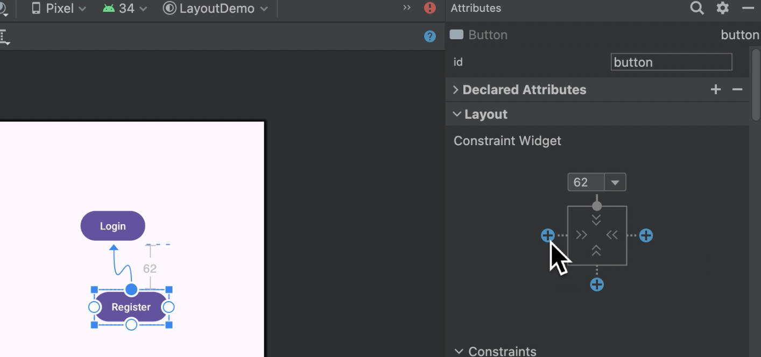
Constraint attributes and creating constraints
Create constraints
Method 3: use constraint simulation table
Example: Create top constraint with nearest view, margin 62dp

Slide 11
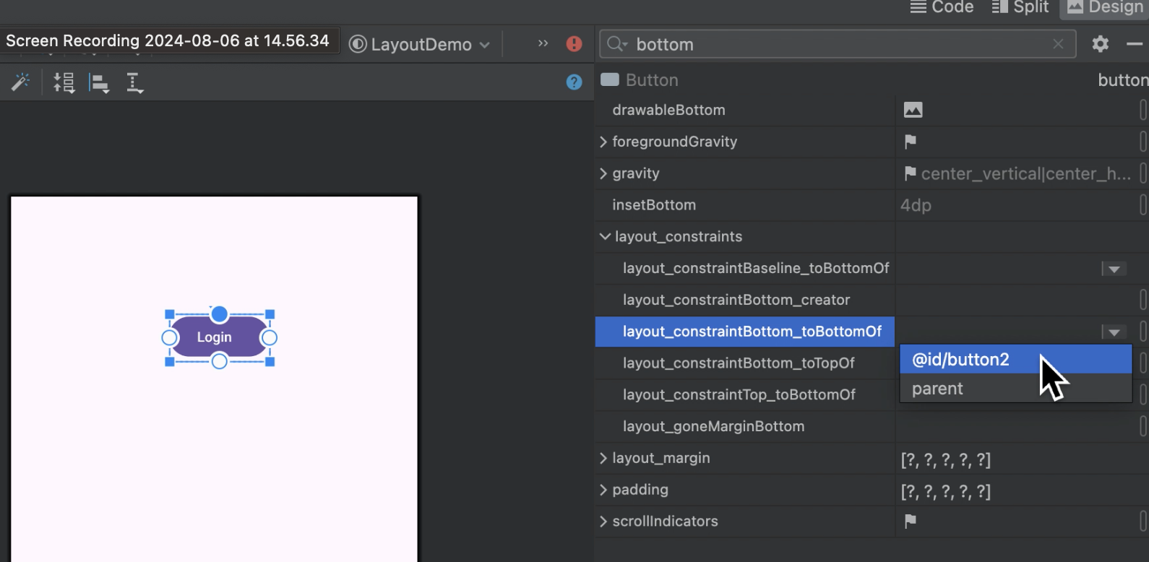
Constraint attributes and creating constraints
Create constraints
Method 4: use constraint attributes from attribute window
Example: assign bottom to bottom of button2 view

Slide 12
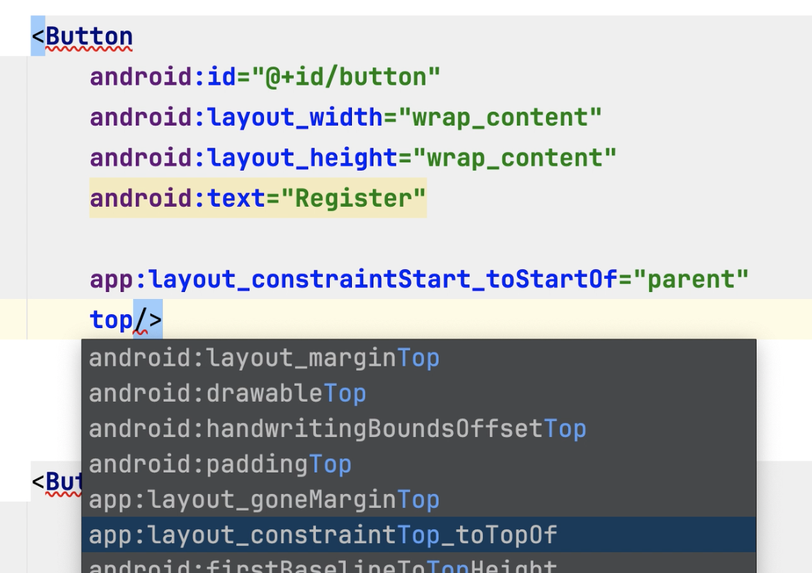
Constraint attributes and creating constraints
Create constraints
Method 5: use constraint attributes on XML code

Slide 13
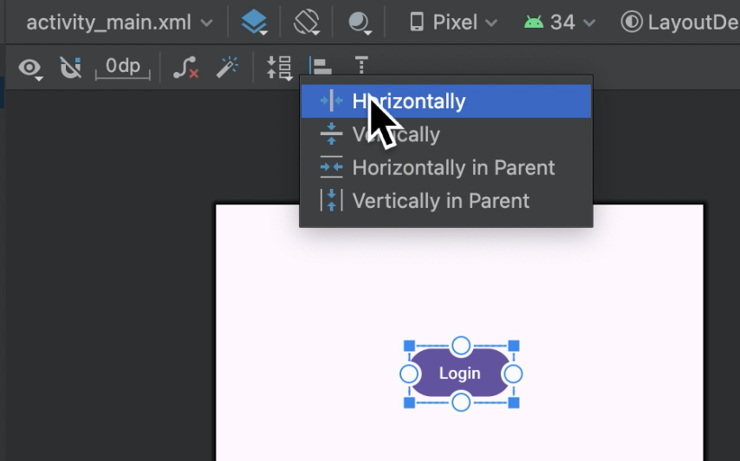
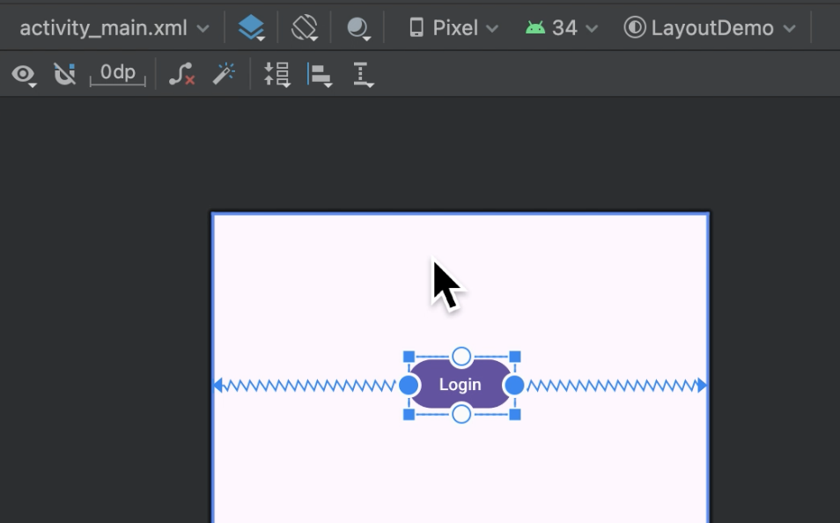
Constraint attributes and creating constraints
Alignment
Center in horizontal inside its constraint

Slide 14
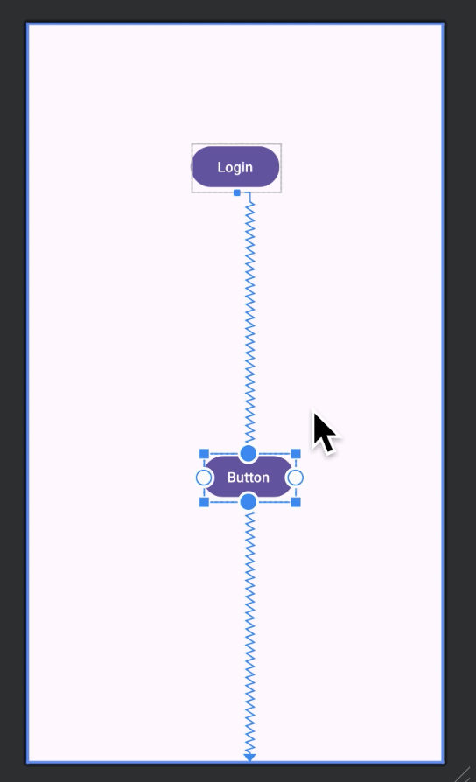
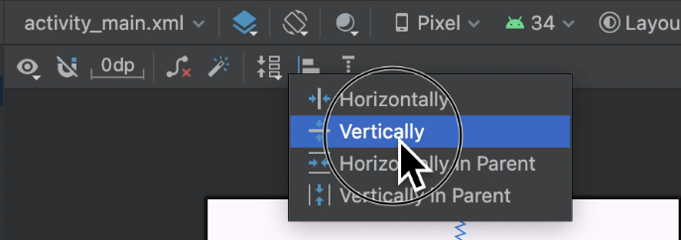
Constraint attributes and creating constraints
Alignment
Center in vertical inside its constraint

Slide 15
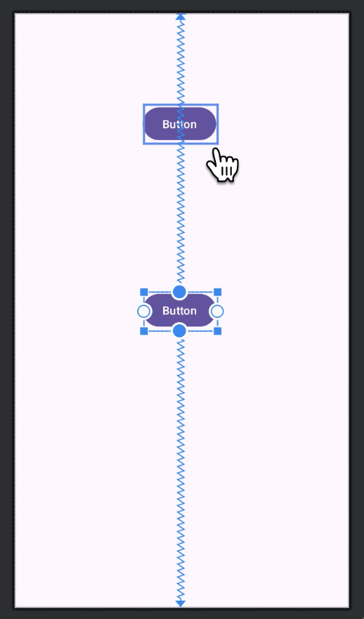
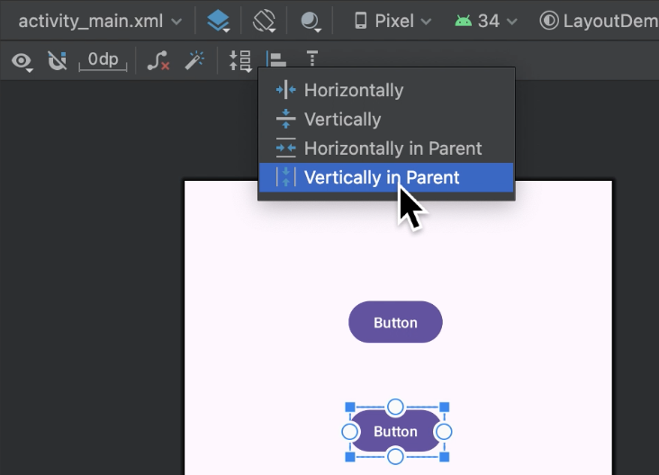
Constraint attributes and creating constraints
Alignment
Center in vertical inside its parent

Slide 16
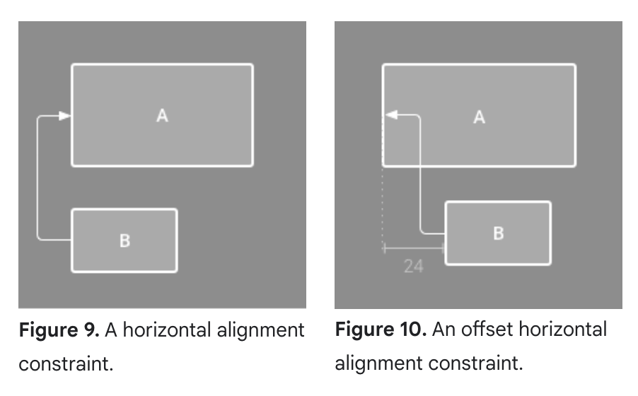
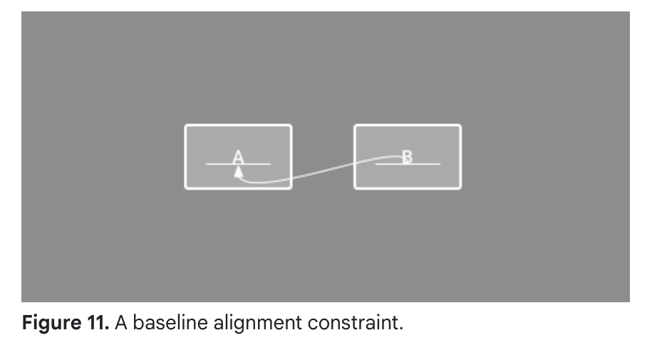
Constraint attributes and creating constraints
Other Alignments

Slide 17
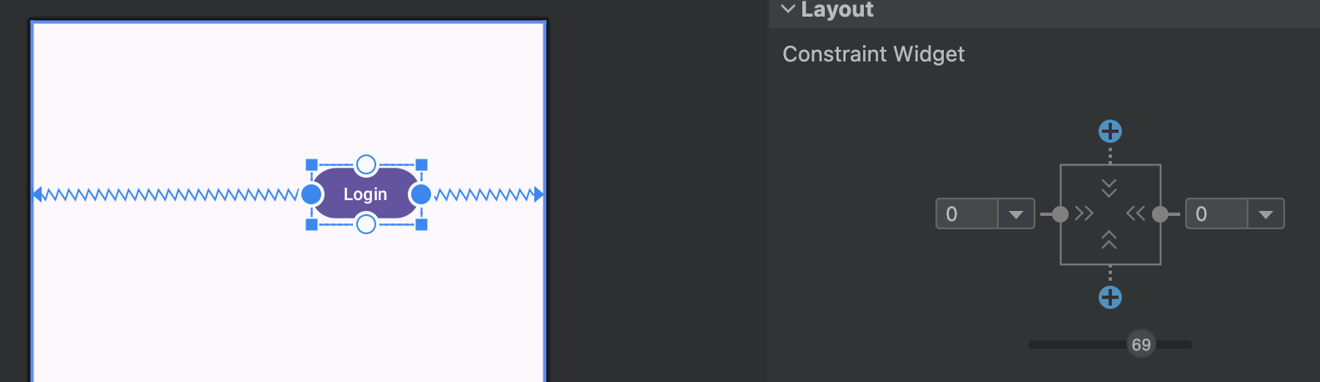
Constraint attributes and creating constraints
Bias

Slide 18
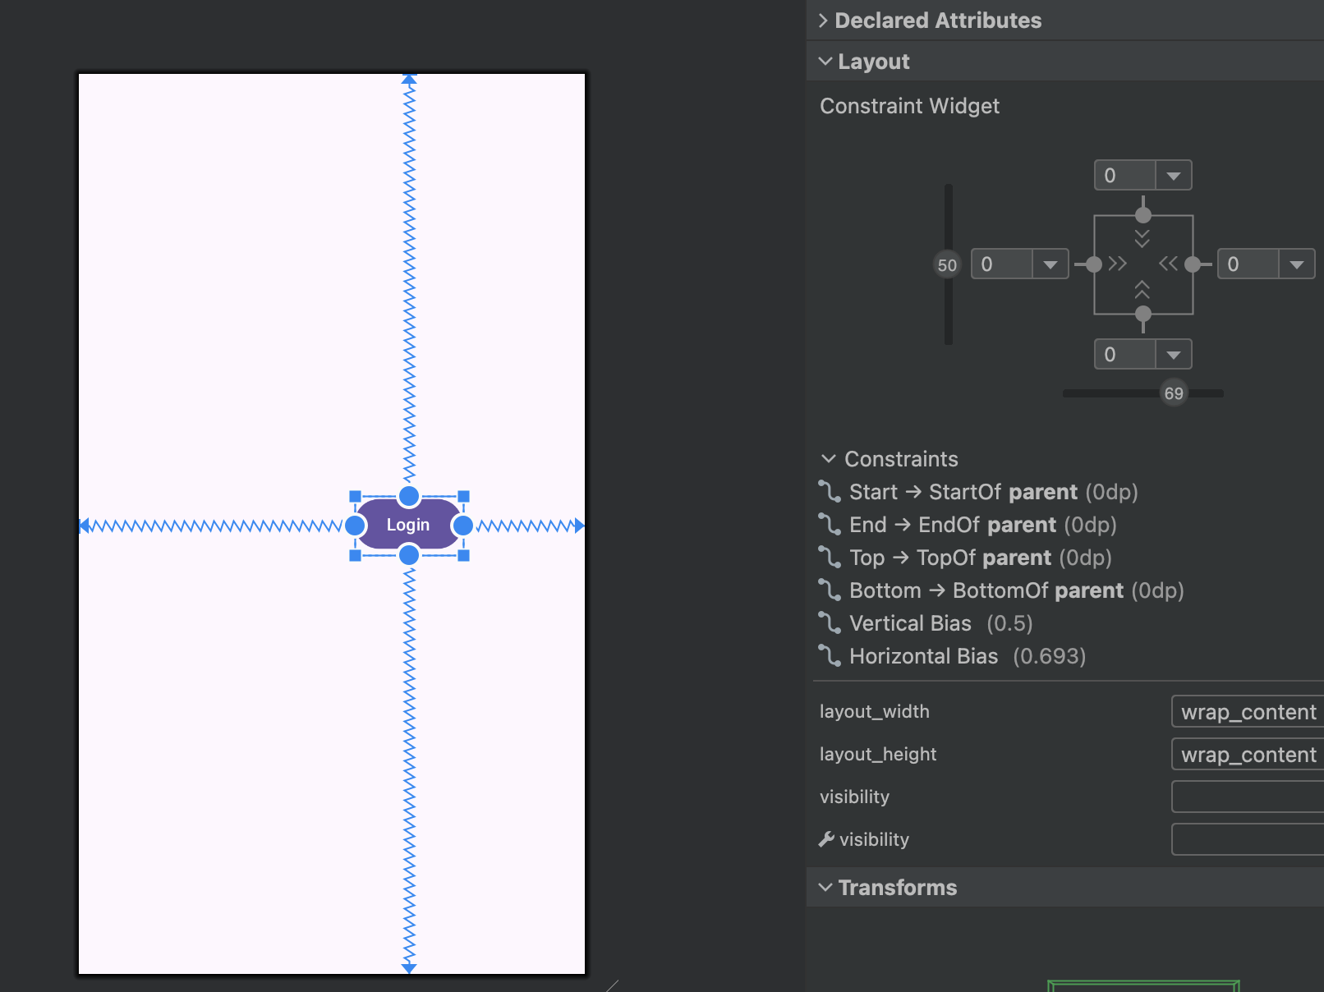
Constraint attributes and creating constraints
Bias:
Example: bias = 69,
Mean the position is at 69% of screen width

Slide 19
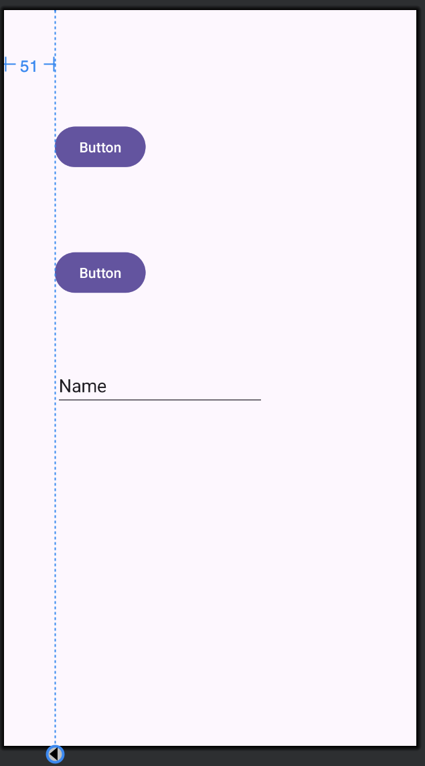
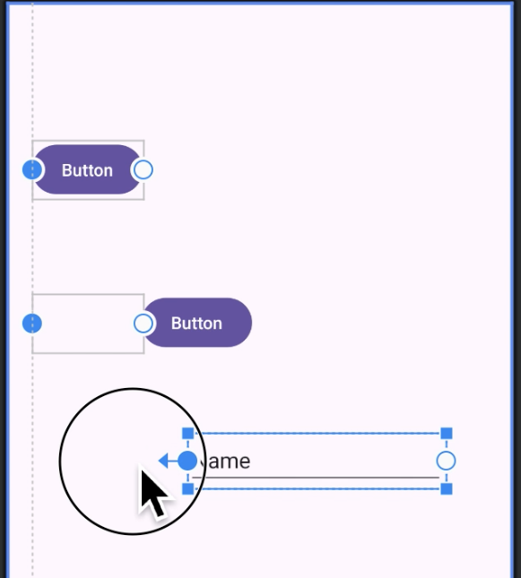
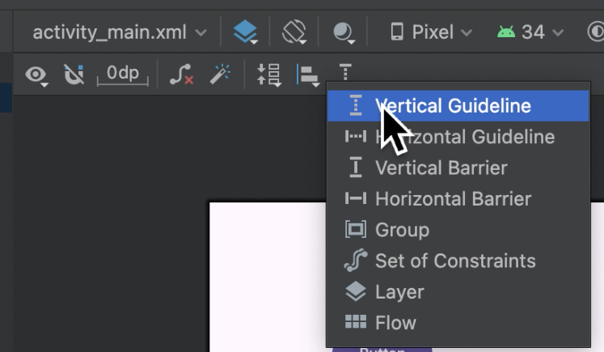
Margin - Using guideline

Slide 20
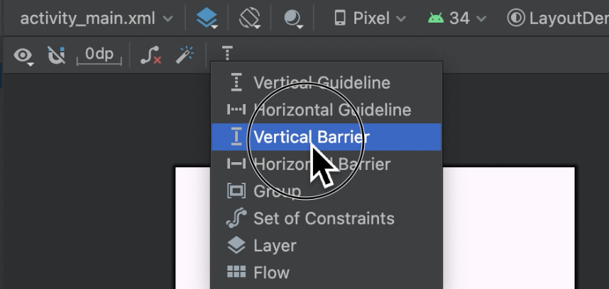
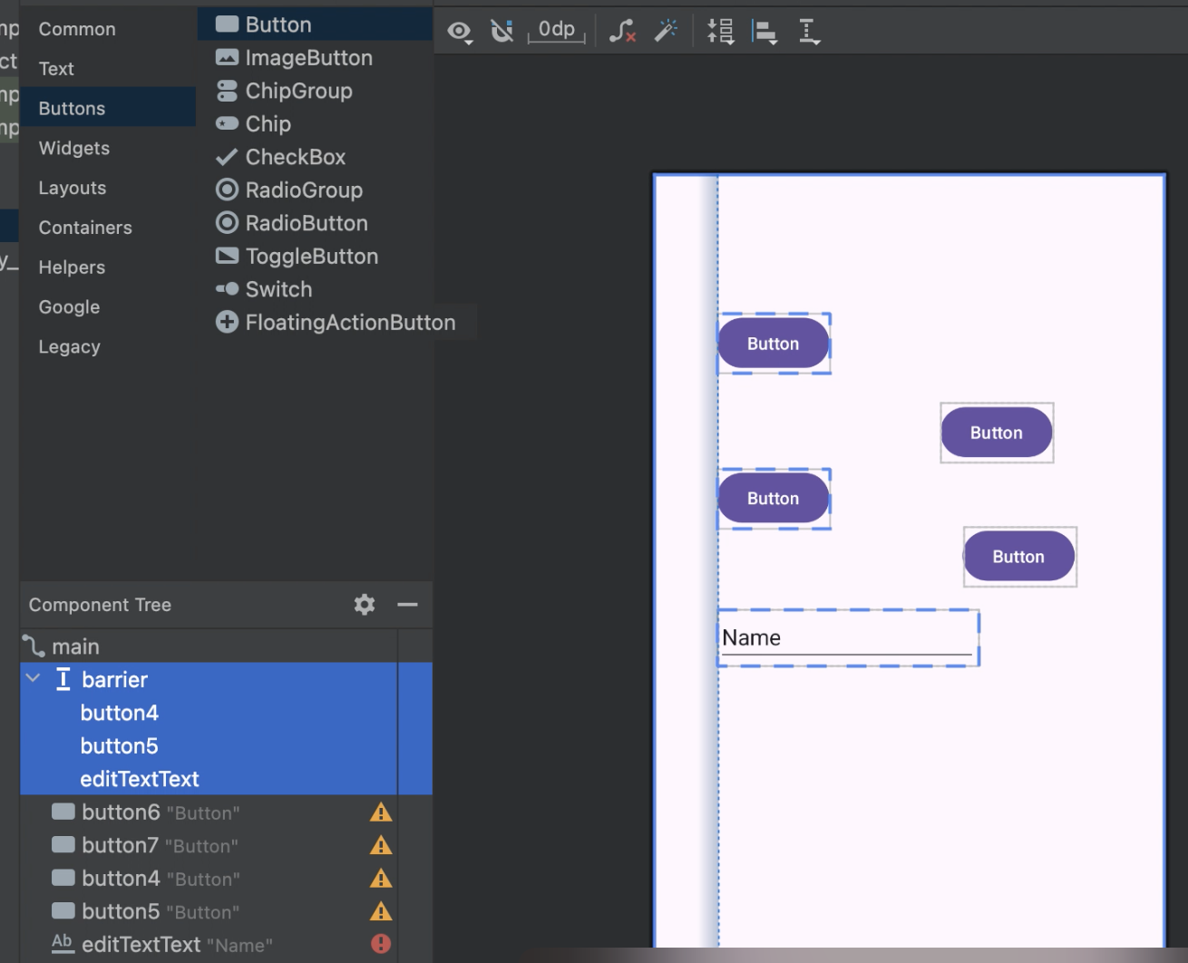
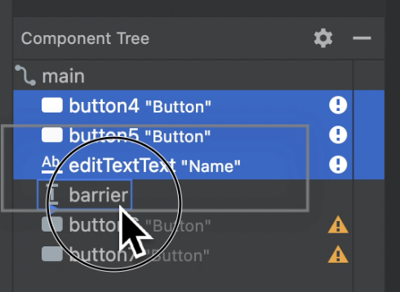
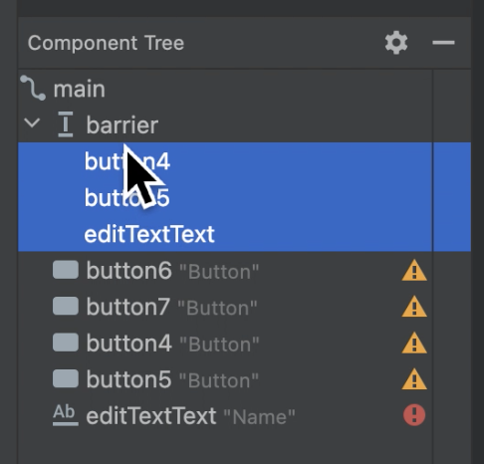
Using barrier

Slide 21
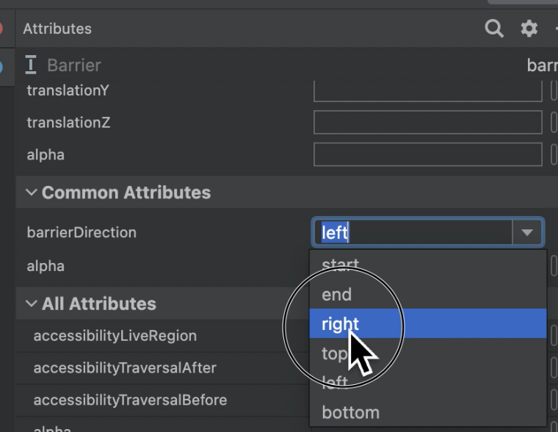
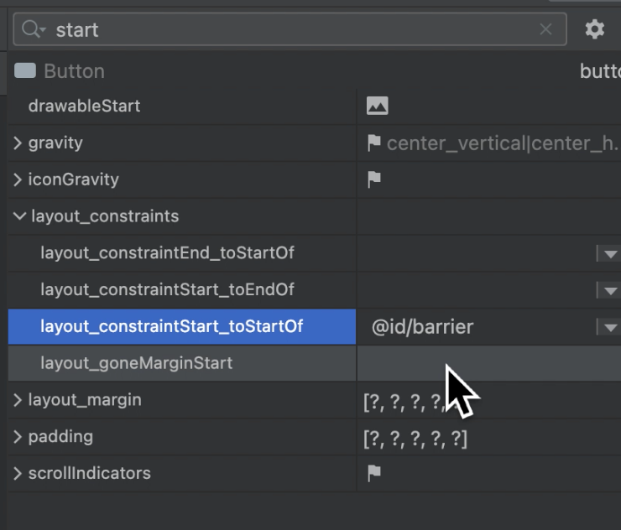
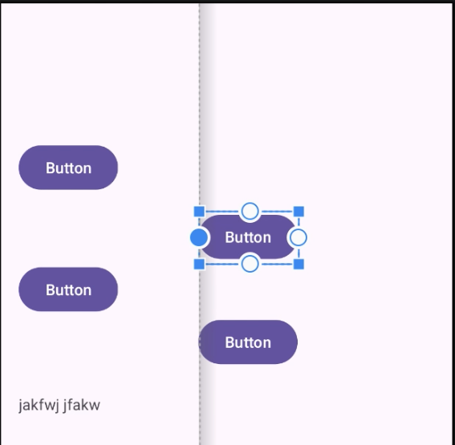
Using barrier

Slide 22
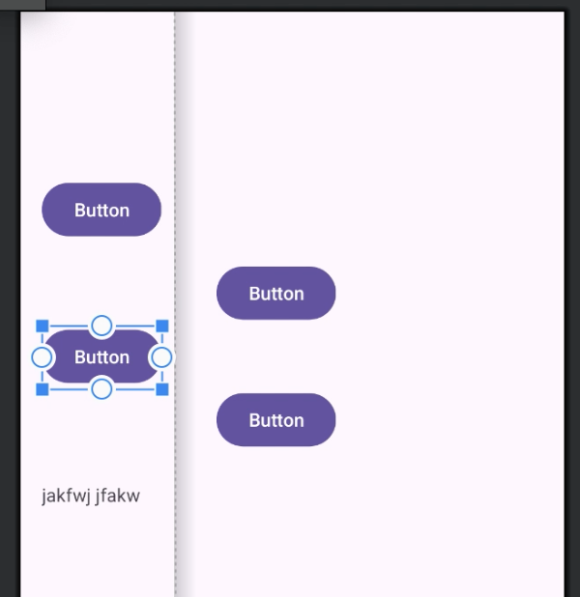
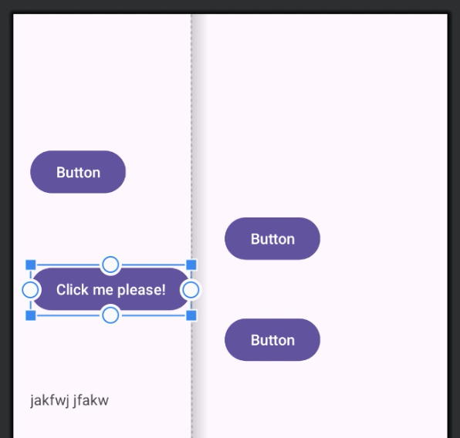
Using barrier
The text of focused button change -> the width change -> the barrier move
the rights buttons move along the barrier.
When the width of any left views change, the left views and the right views never overlap

Slide 23
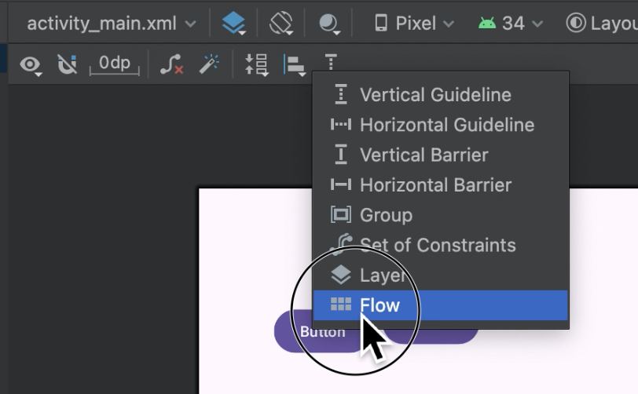
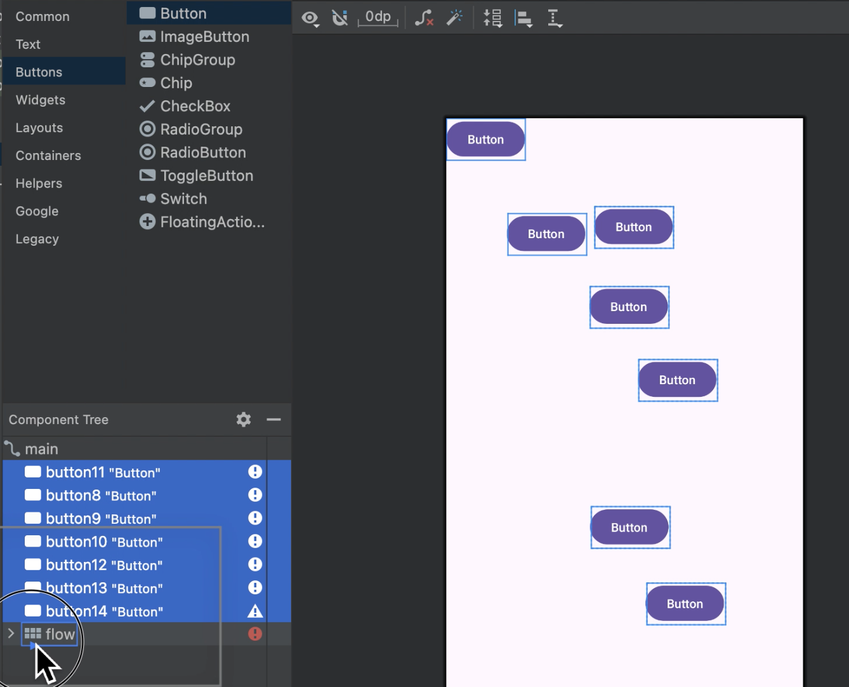
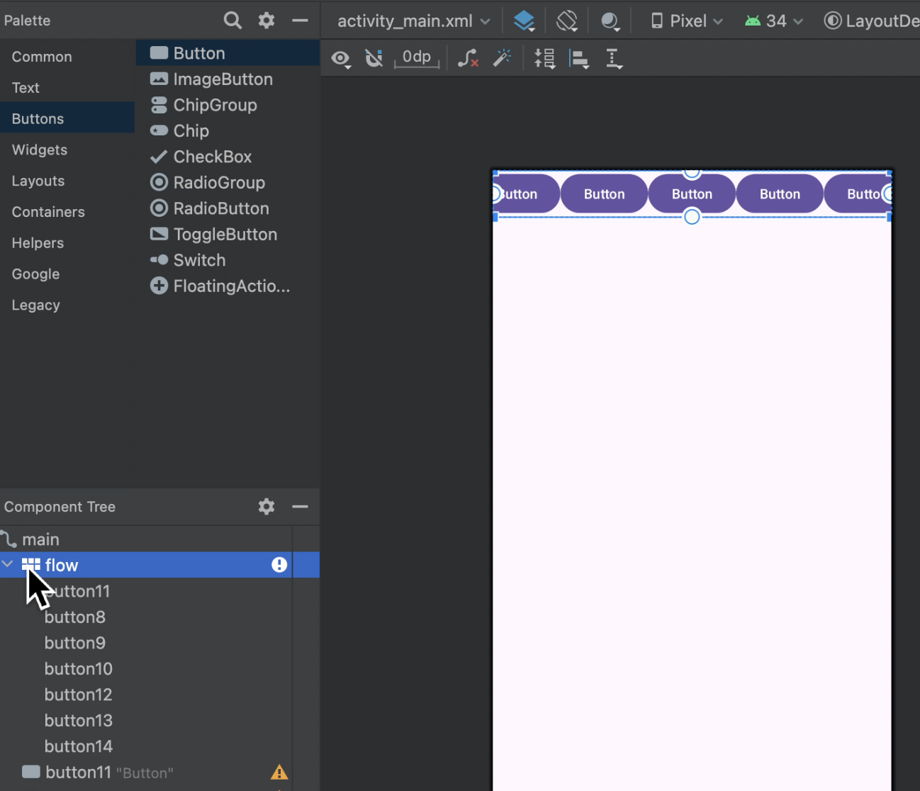
Using Flow
Create flow with wrap-mode: none

Slide 24
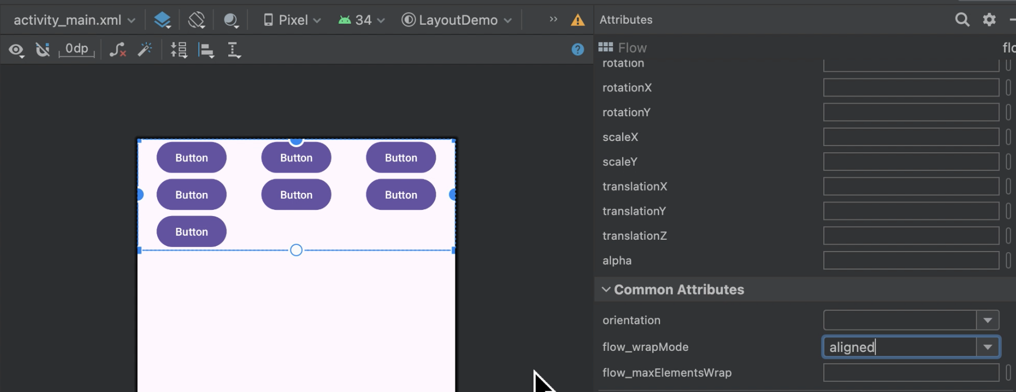
Using Flow
Create flow with wrap-mode: aligned

Slide 25
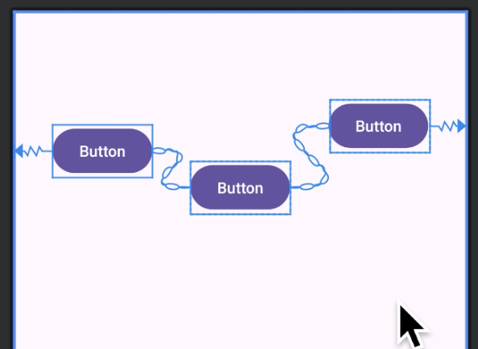
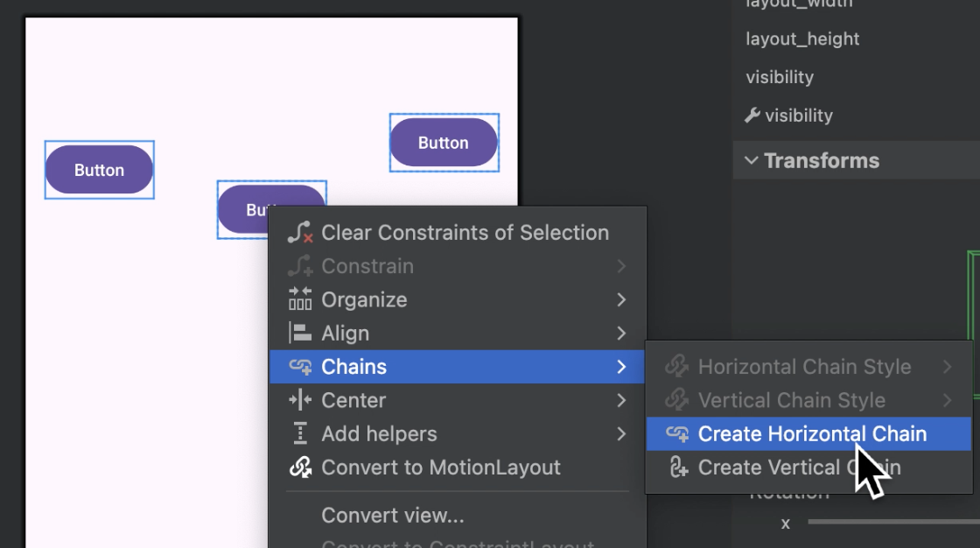
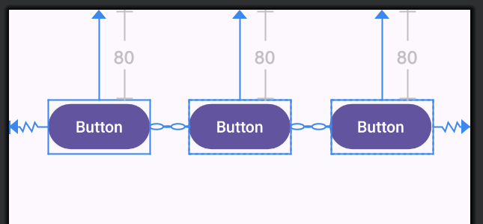
Using Chain
Create flow with wrap-mode: aligned

Slide 26
Others features
Function: wrap-content, match-constraint, match-parent, pack
Group
Layer

Slide 27
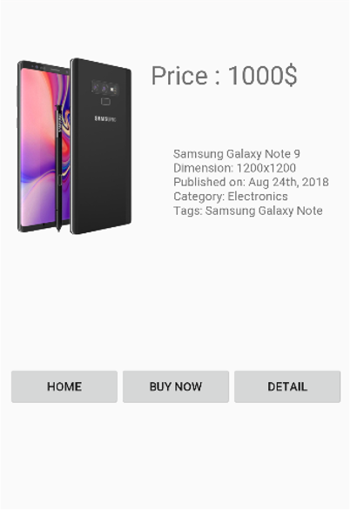
Practice: Let’s design!

Slide 28
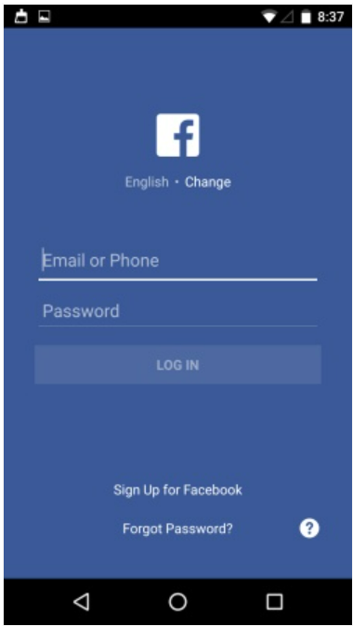
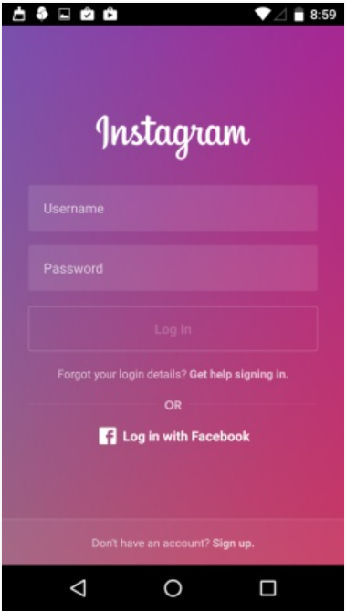
Practice 2
Design one of Login Screens as below (no need color & theme)

Slide 29
References
https://developer.android.com/develop/ui/views/layout/constraint-layout

